Slide 1

ITC6002: Exploring and Analyzing Data Fall Term 2023 Professor: Dr. Constantinos Papadias
Applications of different forecasting methods on stock price data
Alkiviadis Kariotis
Christos Tryposkiadis
Elisavet Kollarou
Panagiotis Kounelis

Slide 2

Agenda
Dataset Acquisition & Description
Data Used & Preprocessing
Forecasting Methods
Naïve Approach
Moving Average Approach
Simple Exponential Smoothing
Trend Adjusted Exponential Smoothing
Seasonality Adjusted Exponential Smoothing
Adjust Best Forecast method with A/F Ratios

Slide 3
Dataset Acquisition Description
Historical stock price data for Apple Inc. (ticker symbol → 'AAPL’ )
Source: Yahoo Finance Python Library
Total time period of 5 years: 01-01-2017 and 31-12-2021
Data format was on daily basis
Dataset is separated into 6 columns:
Date: Day for which the stock price data was recorded
Open: Opening price of the stock on that day
High: Highest price at which the stock traded during the day
Low: Lowest price at which the stock traded during the day
Close: Closing price of the stock on that day
Adj Close: The adjusted closing price of the stock.
Volume: Trading volume for that day → total number of shares of the stock traded

Slide 4
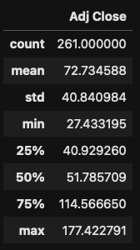
Data Used & Preprocessing
Used the [Date column] → we transformed it to weekly basis
Selected [Adj. Close] column, since this price is adjusted for various factors such as dividends, stock splits, and other corporate actions to provide a more accurate reflection of the stock's value over time
Checked both columns for the existence of NA values or for any duplication
Used the z-score formula, with threshold of 3 → comparing each data point absolute z-score with it
Statistics for the [Adj. Close]

Slide 5
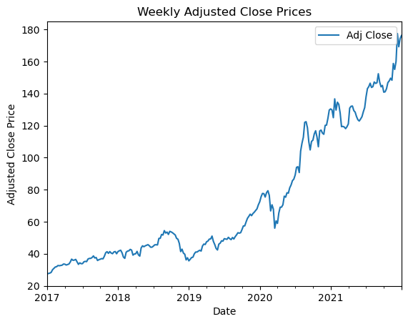
Adjusted Closing Price of Apple : 2017-2022

Slide 6
Forecasting Methods & Dataset Split
First Approach: Naive Approach
Second Approach: Moving Average
Third Approach: Exponential Smoothing
To find the best forecasting model based on our data and its parameters we used metrics such as:
Mean Absolute Deviation
Mean Squared Error
We split our dataset into train and test
Test was used only in the last part → test how our model performed
To optimize the parameters on the models we split our train dataset into train_train and train_validation
Test is the fifth year
Train is 1-4th year
train_train is 1-3rd year
train_validation is the 4th year

Slide 7
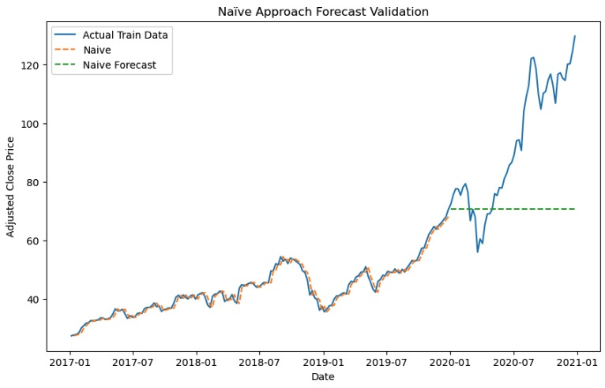
Naive Approach in Validation Set
Simple time series forecasting approach
Assumes the last observation is the best predictor for future observations
Keeps the last known value and uses it as the prediction for all future points
Used as baseline for the more complex methods
MAD: | 23.93
MSE: | 927.41

Slide 8
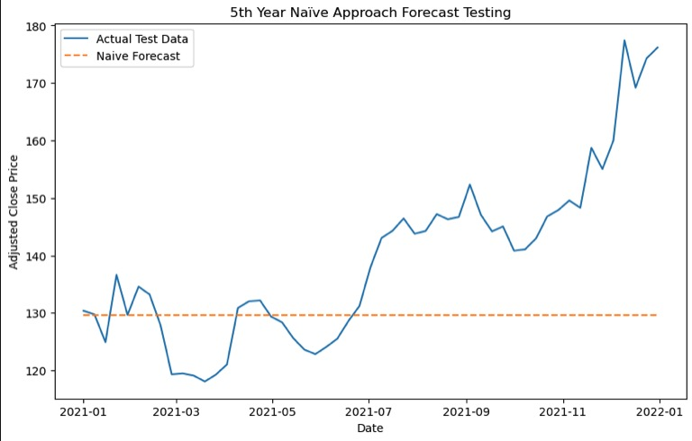
Naive Approach Actual Forecast
Actual Forecast for the 5th year of 2021 to 2022
MAD: | 13.16
MSE: | 309.61

Slide 9
Moving Average
With the use of python, we assessed the performance of moving average forecasting with various window sizes (from 2 until 156 window) on the given stock dataset
We visualized and evaluate the accuracy of the different parameters through different evaluation metrics → providing insights on how window size impacts forecasting performance
In this method, when we reached towards the last points of the 3rd year (Validation set) and 4th year (Actual Forecast) → in simpler terms when we don’t have actual values, to compute the average we took into account the generated forecast values

Slide 10
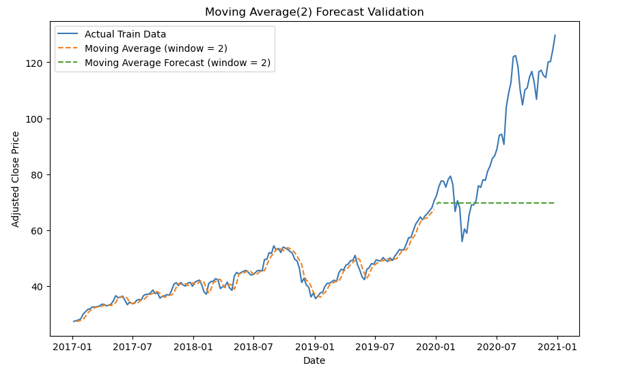
Moving Average Forecast in Validation Set
Used loops from window 2 until the length of the train set, in python to identify the window that gives the best minimum metrics in terms of MAD & MSE
After the loops we got the best results shown below, for the window of 2
MAD: | 24.52
MSE: | 965.09

Slide 11
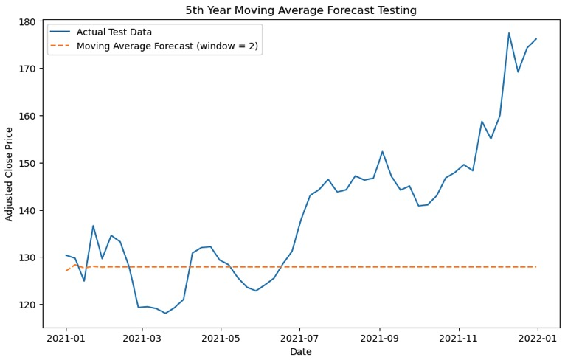
Moving Average Actual Forecast
Actual Forecast for the 5th year of 2021 to 2022
MAD: | 13.94
MSE: | 345.58

Slide 12
Simple Exponential Smoothing
With the use of python, we assessed the performance of exponential smoothing forecasting with various alpha values.
We visualized and evaluate the accuracy of the different parameters through different evaluation metrics → providing insights on how alpha (smoothing level) impacts exponential forecasting performance.

Slide 13
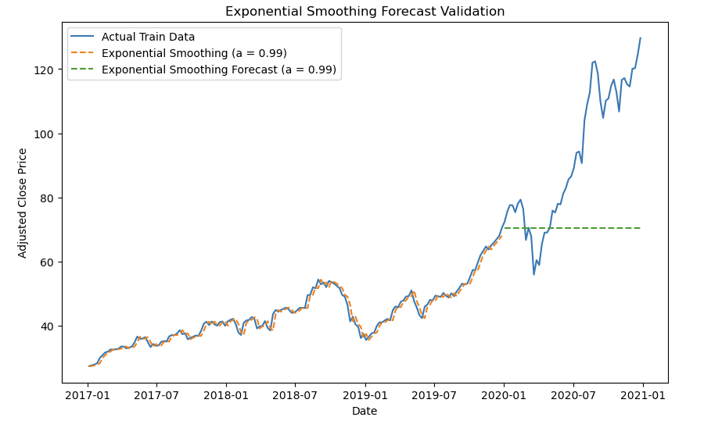
Simple Exponential Smoothing Forecast in Validation Set
Used loops from 0.01 to 1 with step 0.01 in python to identify the alpha that gives the best minimum metrics in terms of MAD & MSE
After the loops we got the best results shown below, for the alpha equals 0.99
MAD: | 23.95
MSE: | 928.53

Slide 14
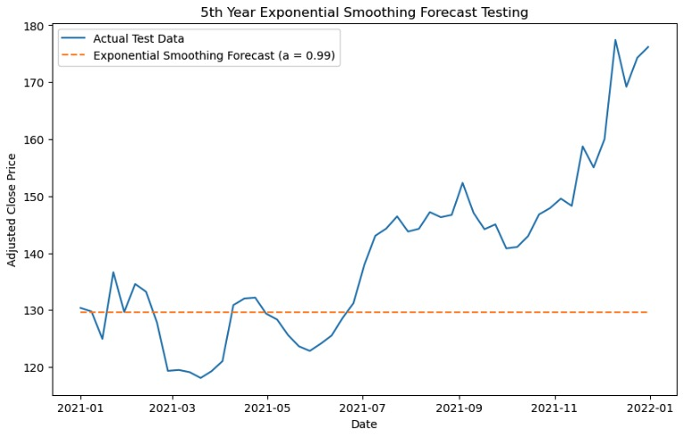
Simple Exponential Smoothing Actual Forecast
Actual Forecast for the 5th year of 2021 to 2022
MAD: | 13.18
MSE: | 310.61

Slide 15
Results of all three methods
Naïve Forecast | Moving Average Forecast | Simple Exponential Smoothing Forecast
MAD: 13.16 | MAD: 13.94 | MAD: 13.18
MSE: 309.61 | MSE: 345.58 | MSE: 310.61
Without trend and seasonality adjustments, we can observe that the Naïve Forecast method brings back a little bit better results than the other two methods that we tested.

Slide 16
Trend-Adjusted Exponential Smoothing Forecast
This method aims to provide a more comprehensive forecasting approach, considering both short-term variations and the overall trend observed in the historical data.
Used loops from 0.01 to 1 with step 0.01 in python, to identify the best combinations of alpha and beta that will result in the best minimum metrics in terms of MAD & MSE
alpha | 0.01
beta | 0.53
MAD: | 7.48
MSE: | 86.68
alpha | 0.03
beta | 0.77

Slide 17
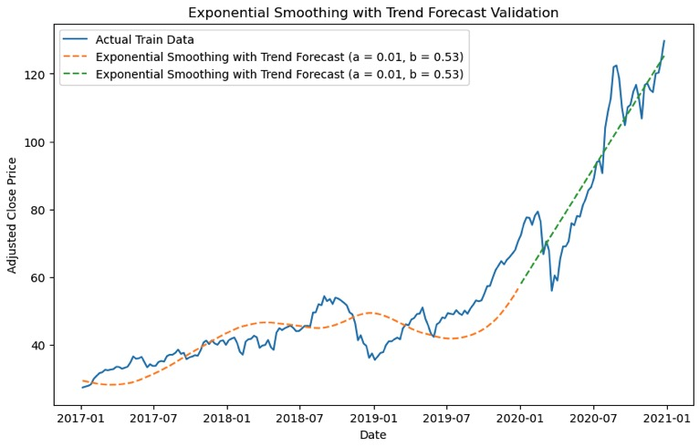
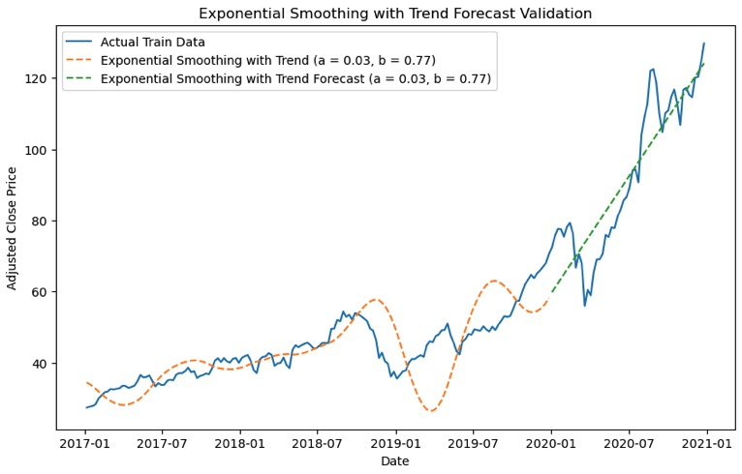
Trend-Adjusted Exponential Smoothing Forecast in Validation Set
MAD: | 7.48
MSE: | 87.81
MAD: | 7.52
MSE: | 86.68

Slide 18
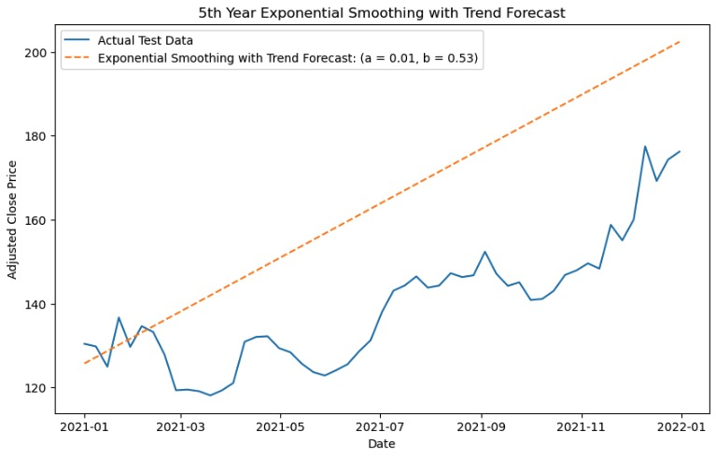
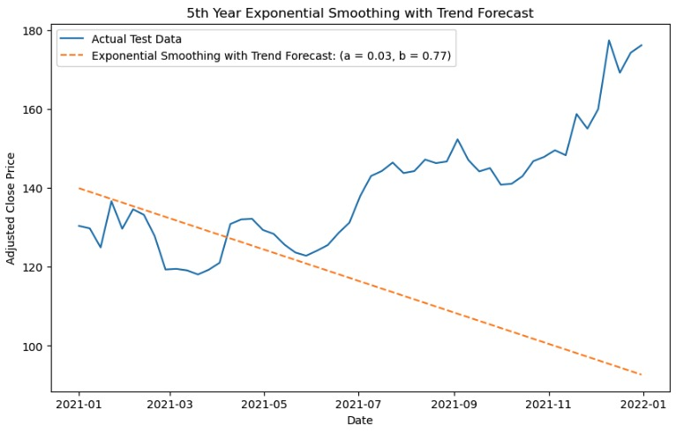
Trend-Adjusted Exponential Smoothing Actual Forecast
MAD: | 25.47
MSE: | 786.85
MAD: | 27.10
MSE: | 1280.73

Slide 19
Seasonality-Adjusted Exponential Smoothing Forecast
alpha | 0.02
beta | 0.32
gamma | 0.01
This method aims to provide a more comprehensive forecasting approach, considering in combination with the trend factor and the seasonality aspect
Used loops from 0.01 to 1 with step 0.01 in python, to identify the best combinations of alpha, beta and gamma at the same time, that will result in the best minimum metrics in terms of MAD & MSE
MAD: | 7.84
MSE: | 94.82
alpha | 0.06
beta | 0.16
gamma | 0.02

Slide 20
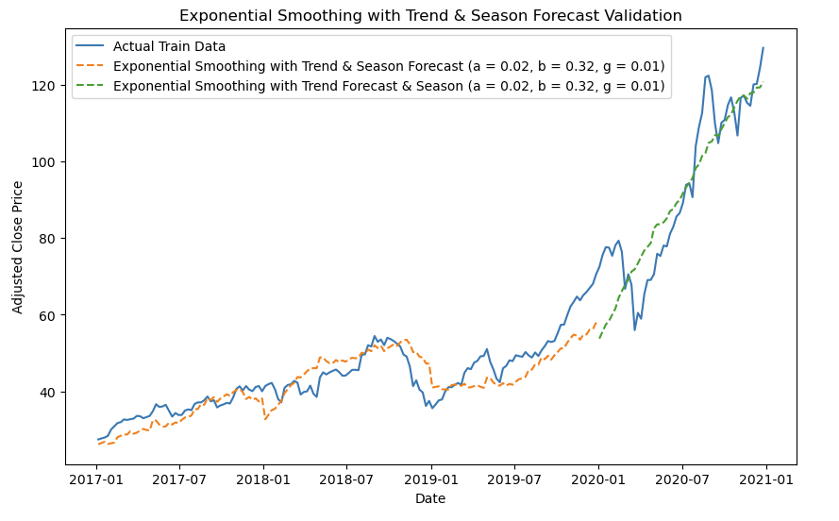
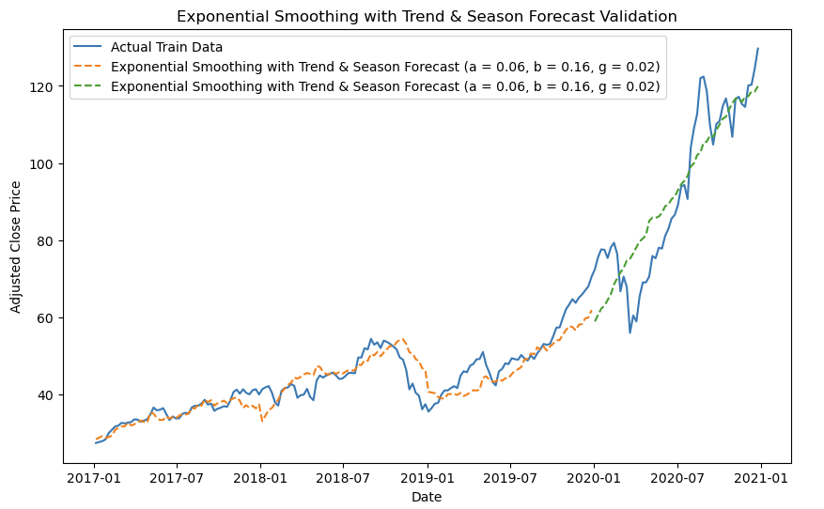
Seasonality-Adjusted Exponential Smoothing Forecast in Validation Set
MAD: | 7.84
MSE: | 100.35
MAD: | 7.99
MSE: | 94.82

Slide 21
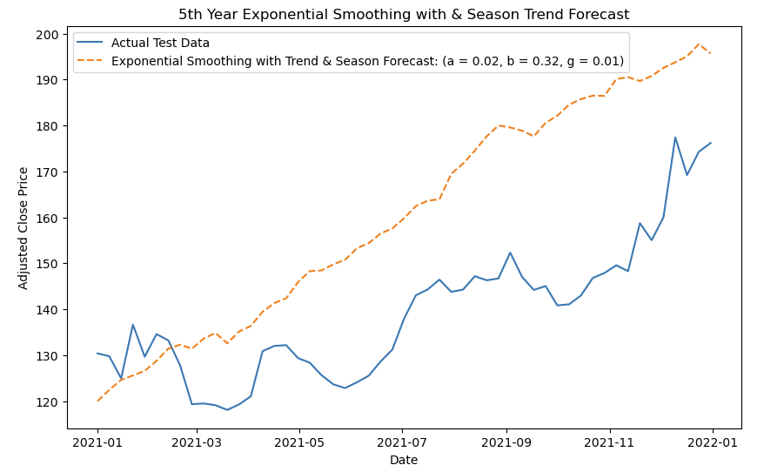
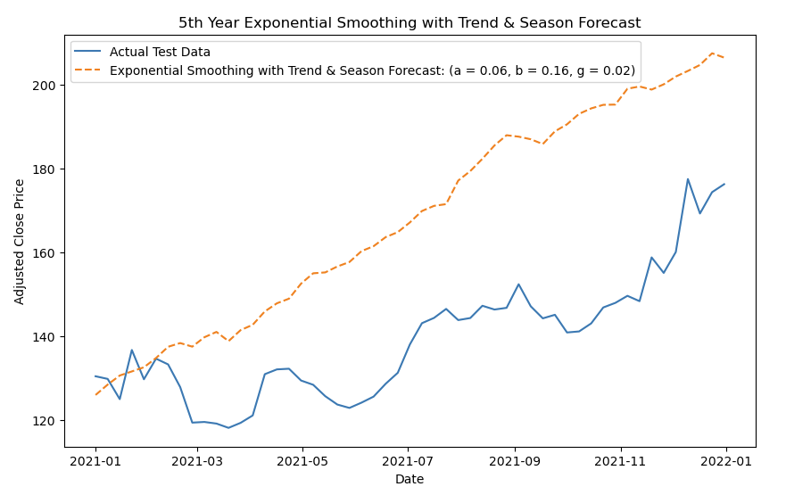
Seasonality-Adjusted Exponential Smoothing Actual Forecast
MAD: | 22.82
MSE: | 654.58
MAD: | 29.16
MSE: | 1052.66

Slide 22
A/F Ratios on Naïve Forecast
We converted the Apple stock data into monthly intervals instead of weekly
We obtained for the same time period (2017-2022) stock data from 10 different companies
Microsoft Corporation - MSFT
Amazon.com, Inc. - AMZN
Google (Alphabet Inc.) - GOOGL
Facebook (Meta Platforms, Inc.) - META
Tesla, Inc. - TSLA
Berkshire Hathaway Inc. - BRK-B
Johnson & Johnson - JNJ
JPMorgan Chase & Co. - JPM
Visa Inc. - V
Coca-Cola - KO
In order to calculate the A/F Ratio of each company, we consider our forecast the second to last day of the 4th year and our actual Adj Closed Price was the last day of the 4th year
Computed the mean of all the A/F Ratios of the 10 companies
Naïve Forecast for the 5th year for Apple
Multiply the mean in the Naïve Forecast for Apple (A/F Adjustment)

Slide 23
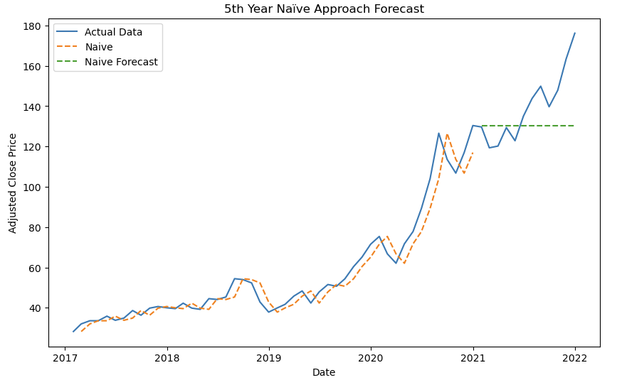
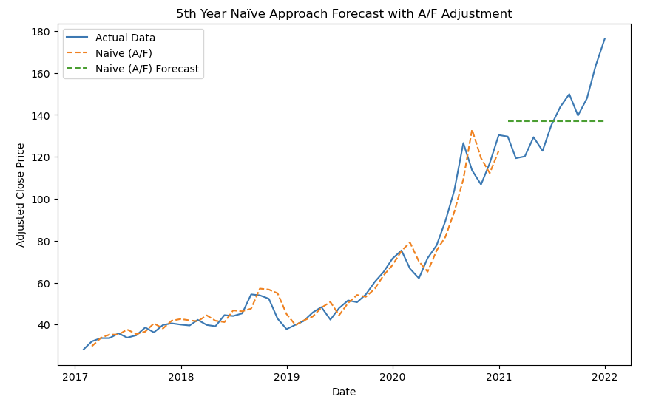
A/F Ratios on Naïve Forecast
Simple Naïve Forecast
Naïve Forecast with A/F Adjustment
MAD: | 14.48
MSE: | 370.71
MAD: | 13.70
MSE: | 290.30

Slide 24
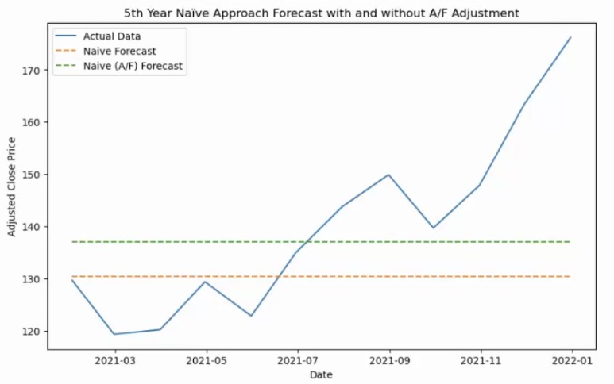
Comparison of Naïve & Naïve A/F Adjusted

Slide 25

Thank you and we wish you Happy Holidays!

